Slide 1
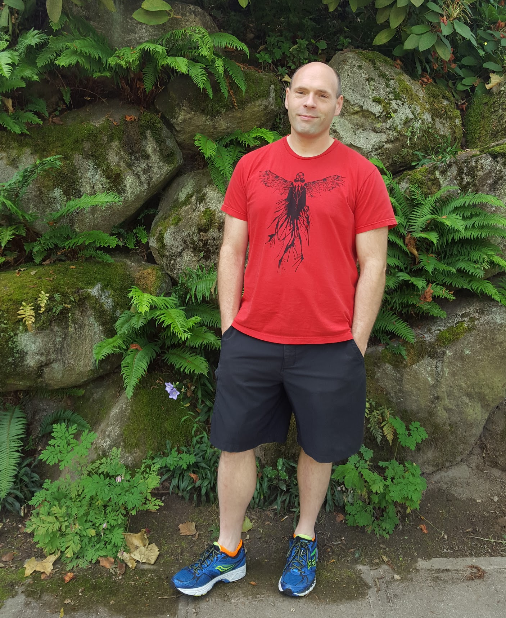

(NOTE: PASTE IN PORTRAIT AND SEND BEHIND FOREGROUND GRAPHIC FOR CROP)
Application Deployment and Management at Scale with 1&1
Matt Baldwin
CEO
@stackpointcloud
Notes:
Pause for quick intro about speaker.

Slide 2

Who is 1&1?
Notes:
Pause here and provide a description of 1&1.
1&1 is one of the world’s leading Web hosting providers. 1&1 currently offers a wide range of Web hosting products, including email solutions and high-end servers in 10 different countries including Germany, Spain, Great Britain and the United States.
Audience may remember them from their 2-years of web hosting for free campaign in the U.S., shaking up the U.S. web hosting market.
Positions itself as a one-stop Internet shop -- domain registration, web hosting, site creation, etc.
Cloud Server offering
Dedicated Server
Application deployment via Bitnami

Slide 3

(NOTE: PASTE IN PHOTO AND SEND BEHIND FOREGROUND GRAPHIC FOR CROP)
What We Do
Customers push their own code, we manage the stack and infrastructure.
Secure, multi-tenant environment
70,000 Machines
Millions of Active Websites
7 Global Data Centers
Notes:
Stack being things like LAMP, etc.
Very scalable single-purpose servers for Apache, MySQL and other core technologies
Care has been taken to securely support multi-tenancy within each shared process
datacenters:
Germany (2)
USA (2)
France (1)
Spain (1)
UK (1)
The objective is to allow customers to maintain their workflow from shared hosting environments. They upload their PHP files to a managed environment where the files are run. They don't do any server or environment management.

Slide 4
(NOTE: PASTE IN PHOTO AND SEND BEHIND FOREGROUND GRAPHIC FOR CROP)
Our Challenges
“One Stack Fits All” approach to application hosting and management:
Rigid, monolithic
Innovation is challenging
Painful update process for shared components.
Large effort to maintain several Linux kernels due to varied infrastructures.
Notes:
Rigid, monolithic stacks
Update issues
· „one stack fits all“
· challenges for innovative additions - This reduced feature set 1&1 could offer their customers over time.
· complete updates of stack, even when components change
· takes a lot of efforts to maintain different Linux kernels (with Dedicated Managed)

Slide 5
1&1’s Future is Docker

Slide 6
(NOTE: PASTE IN PHOTO AND SEND BEHIND FOREGROUND GRAPHIC FOR CROP)
Current Architecture
Tenant DB #1
Tenant DB #2
Tenant DB #N
Monolithic Hosting carves up resources and multi-tenants components.
Single MySQL Instance
Single Apache Instance
Single Host
Shared CPU and Memory
All services access the same storage
VHOST #N
VHOST #3
VHOST #2
VHOST #1
MySQL
Apache
Host Server
Notes:
Apache is installed once on a server and VHOSTS are set up in different Linux user contexts for all the different websites. MySQL is again only installed once, with websites configured for different MySQL users.
Single DB Solution == MySQL
Single Web Server Solution == Apache
MySQL performance is shared by all DBs
Apache is configured for all sites' requirements - no variation is supported (e.g. there isn't a 'rails environment' and a 'PHP 7 environment' - there is one environment that tries to do a reasonable job across all languages)
The whole server is a single failure domain. Additionally when the OS is patched, the whole server might need to be rebooted.
Security must be maintained by MySQL and Apache processes and Linux user context - reducing the services we can offer to those that natively support multi-tenancy (i.e. multiple Linux user contexts that are not allowed to see each others settings etc.)
Host Failure results in a customer app outage.
Host Update results in a customer app outage.

Slide 7
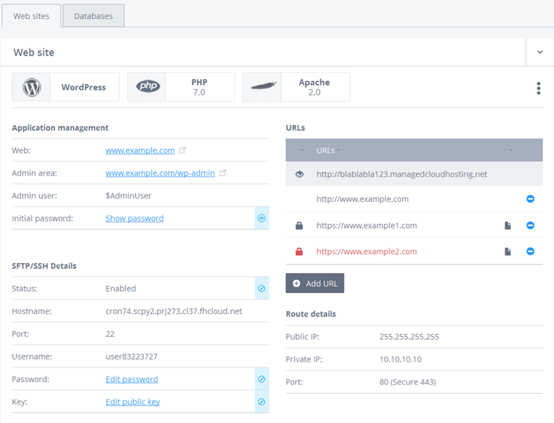
(NOTE: PASTE IN PHOTO AND SEND BEHIND FOREGROUND GRAPHIC FOR CROP)
Our Next Gen Goal
More choice, better scalability -- customer need drives our design goals.
Richer Components - Caches, Queues, etc.
Broader SQL and NoSQL support
Reduce SPOF
Workload portability
Eliminate Resource Contention
Notes:
SPOF == Single Points of Failure
Richer Components = Caches, Queues, and other services. == e.g. redis.
Product Diversification. No more McDonaldization. Customers can assemble their own components.

Slide 8
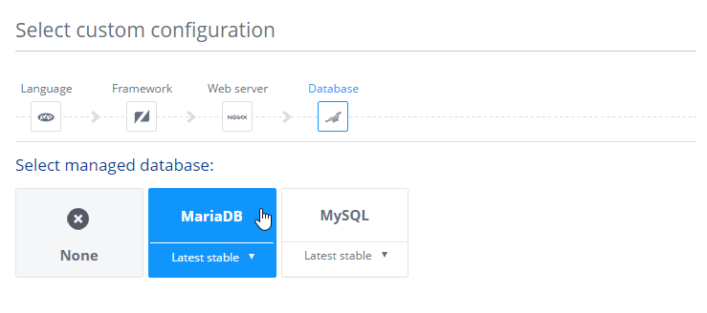
(NOTE: PASTE IN PHOTO AND SEND BEHIND FOREGROUND GRAPHIC FOR CROP)
Future Architecture
We broke the monolith up: shared components are now containers:
Everything is a container.
Mix and match web server and database solutions.
Immediate component scalability.
Components can be added ad-hoc.
Leverage container ecosystem for solutions.
Notes:
Customers can mix and match: different combinations of web servers (nginx, apache) can be selected and combined with different combinations of database solutions (mariadb, mysql, etc.)
Other components, such as caches, supplemental databases, queues and other tools can be assembled by the customer on a case-by-case basis.

Slide 9
Our Solution

Slide 10
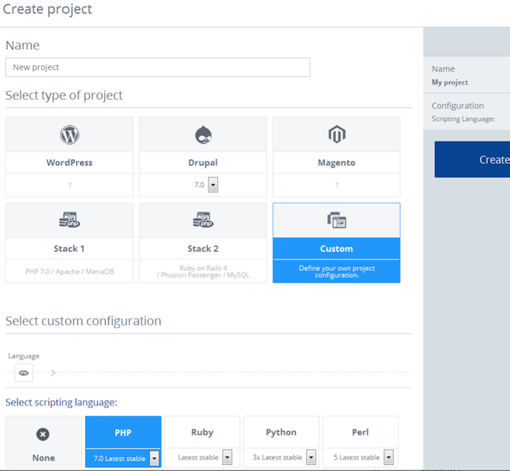
(NOTE: PASTE IN PHOTO AND SEND BEHIND FOREGROUND GRAPHIC FOR CROP)
Provide Choice
Containers allow us to quickly add curated components:
Customers create projects.
Application stacks are either assembled or pre-built.
Usual suspects are supported.
Support scripting languages in use across all sites we host.
Notes:
To ensure broad adoption across the entire web hosting market, UX was a dominant focus: it had to be easy for users pick and choose, ad-hoc, to build, then deploy their stack.
Projects == a bucket of isolation for your containers.
Usual suspects == Wordpress, Apache, MySQL
Stacks are things like nginx + postgres
Components are things like redis, elk, etc.
Scripting Language == Speak towards how this now enables users trapped in the traditional model of web hosting to easily migrate into a highly scalable Docker based CaaS platform powered by leading components in the space.

Slide 11
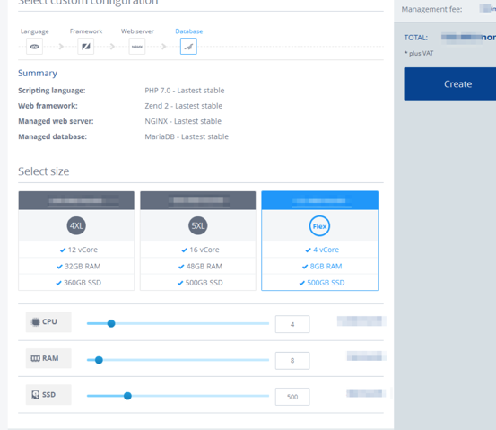
(NOTE: PASTE IN PHOTO AND SEND BEHIND FOREGROUND GRAPHIC FOR CROP)
Better Isolation
The traditional model forced us to multi-tenant the system via permissions, users, groups, and so on. Now:
User projects are deployed to their own dedicated resources.
Strongly isolated networks.
Strongly isolated storage.
1&1 Manages Upgrades, Environment.
Notes:
1&1 Manages Upgrades, Environment:
Management of processes for security (patching web servers, databases, and ensuring upgradability)
Network isolation is done using vxlan (SDN / network overlay)
We mount Gluster volumes into Kubernetes using Kubernetes Flexvolume. Subdirectories of these volumes are then mounted into containers and further protected using standard Linux file permissions (each project runs as its own distinct linux user).

Slide 12
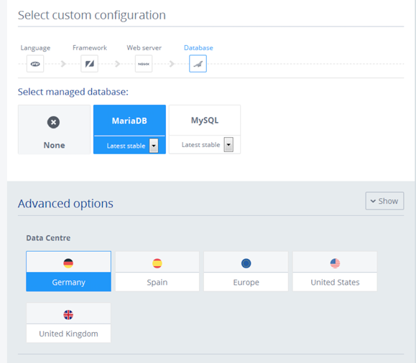
(NOTE: PASTE IN PHOTO AND SEND BEHIND FOREGROUND GRAPHIC FOR CROP)
Better Management
Our own management overhead decreases as usability and choice increases for our users.
Upgrading components has no downtime.
Users have more knobs -- regions, frameworks, kernel versions.
Nodes management is now invisible.
Notes:
Current customers will have:
Established tool chain
Less-technical staff (Agencies)

Slide 13
(NOTE: PASTE IN PHOTO AND SEND BEHIND FOREGROUND GRAPHIC FOR CROP)
Eliminate Failure Points
Treat hosts as fungible.
Servers are cluster members.
Containers are scheduled to nodes.
Containers go to where resources are available.
Components can be scaled independently of each other.
Dynamic Cluster Routing
Kubernetes
Docker
Docker
Docker
Docker
node 01
node 02
node 03
node n
1&1 Cloud
Notes:
Resource scheduling - This can be defined as memory, disk, cpu, etc.
When a node fails containers are automatically rescheduled elsewhere in the cluster.
Component scaling == customers can ask for more replicas for different components and the platform will service that request. This allows users to quickly scale their infrastructure. 1&1 manages all physical components.
They're in separate pods. So NGINX will run in one pod (that we might horizontally scale in future) and MariaDB will be in another. And yes, the scaling is just increasing the replicas.

Slide 14
(NOTE: PASTE IN PHOTO AND SEND BEHIND FOREGROUND GRAPHIC FOR CROP)
Make Storage Easy
Since we manage the app, we manage the storage:
During an upgrade we move the volume to the new container.
Docker images are tested and verified before user environments are updated.
We perform and test the data migration.
Notes:
Resource scheduling - This can be defined as memory, disk, cpu, etc.
When a node fails containers are automatically rescheduled elsewhere in the cluster.
Component scaling == customers can ask for more replicas for different components and the platform will service that request. This allows users to quickly scale their infrastructure. 1&1 manages all physical components.
In the new environment, we need to provide container lifecycle management - upgrading container with new versions as they become available
As we are managing the service on behalf of many 3rd parties we must avoid breaking changes at all costs
Each Docker image is deployed thousands of times - a mistake is costly
It’s insufficient just to check a Docker image doesn’t have breaking changes - we also have to test it interacts with applications in an expected way
The new Docker image is pre-loaded onto the server, the 'old' container is stopped and the 'new' one started in its place. The persistent storage from the old container is mounted to the new.
Containers are designed to be ephemeral - but this is not the environment classic websites are written to use, nor something that suits databases.
We test upgrade of each Docker Image, with persistent storage created by the previous iteration - also testing any data migration

Slide 15
(NOTE: PASTE IN PHOTO AND SEND BEHIND FOREGROUND GRAPHIC FOR CROP)
Lifecycle Management
We manage the life of the application deployment for the customers:
Containers are automatically upgraded when new versions ship.
Customer content is mounted into their containers externally.
Containers are validated via a bespoke test suite.
Notes:
Resource scheduling - This can be defined as memory, disk, cpu, etc.
When a node fails containers are automatically rescheduled elsewhere in the cluster.
Component scaling == customers can ask for more replicas for different components and the platform will service that request. This allows users to quickly scale their infrastructure. 1&1 manages all physical components.
In the new environment, we need to provide container lifecycle management - upgrading container with new versions as they become available
As we are managing the service on behalf of many 3rd parties we must avoid breaking changes at all costs
Each Docker image is deployed thousands of times - a mistake is costly
It’s insufficient just to check a Docker image doesn’t have breaking changes - we also have to test it interacts with applications in an expected way
The new Docker image is pre-loaded onto the server, the 'old' container is stopped and the 'new' one started in its place. The persistent storage from the old container is mounted to the new.

Slide 16
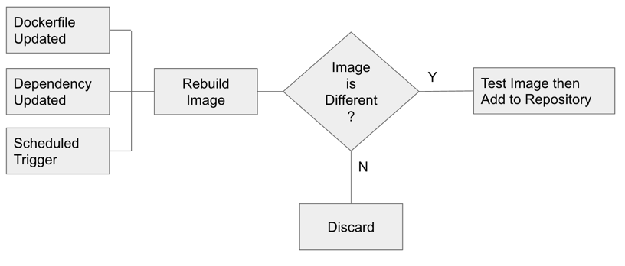
(NOTE: PASTE IN PHOTO AND SEND BEHIND FOREGROUND GRAPHIC FOR CROP)
Automate Proaction
Traditionally it was a manual process to update customer environments.
We watch repositories for the latest, stable versions.
Map app environment dependencies.
Rebuild when a change is scheduled or spotted.
Notes:
Dependency mapping Docker images to application environments, which can then be triggered to re-test themselves
Watching for 3rd party updates / URLs
Watching for repository changes involves using apt or yum to retrieve latest OS packages; we then do a checksum to see if anything changed since the last time it was done.
Watching for 3rd party updates usually involves polling a URL at regular intervals (e.g. every 24 hours) to see if a new binary is available.
We rebuild docker images (that typically use apt or yum) frequently and run a filesystem check to see what’s changed. If we think it has, we push it through the test cycle again.
Applications are combinations of docker images - if a docker image that’s used by an application is updated then the application itself is re-tested too

Slide 17
Application Library
(Git / Gitlab)
Image
Repository
(Dockerhub)
User Interface
Multi-tenant API
CI Stack
(Drone)
Cluster Build / Lifecycle Tooling
CluCluster
Hosting Cluster(s)
Openshift
FreeIPA
Kubernetes
Gluster
Notes:
Left-hand side (in green) is the Library segment of the system. This segment is responsible for holding the catalogue of applications available to the customer. Applications are made up of arrangements of Docker containers. Changes to these applications are either:
Changes to Dockerfiles
Changes to Application templates (how the Docker containers hang together)
Changes to the OS packages or other external files referenced by the Dockerfiles
Any of these changes will trigger tests to be run (committed in Git alongside the Dockerfile, or alongside the application template in the application library, if they are integration tests). Assuming the tests pass, the appropriate Dockerfile or application template will be tagged in a way that makes it available for deployment to a project within a cluster (i.e. for customer use).
The tests are written for Drone - an open source project which easily allows tests to be run within Docker containers.
----
On the right hand side (in grey) we have the in-house software stack that we use to serve up the user interface, to handle authentication and business logic and to manage all of our clusters in all of our datacenters (in the US, Spain, Germany and the UK).
The hosting clusters (of which there are many) run the software shown on the following slide.
FreeIPA handles all user management within a cluster including Linux users, SSH authentication
Within the cluster we run certain services on behalf of the customer - including centralised SSH access (which we proxy into a container connected to the customer’s persistent storage)
Drone - https://github.com/drone/drone

Slide 18
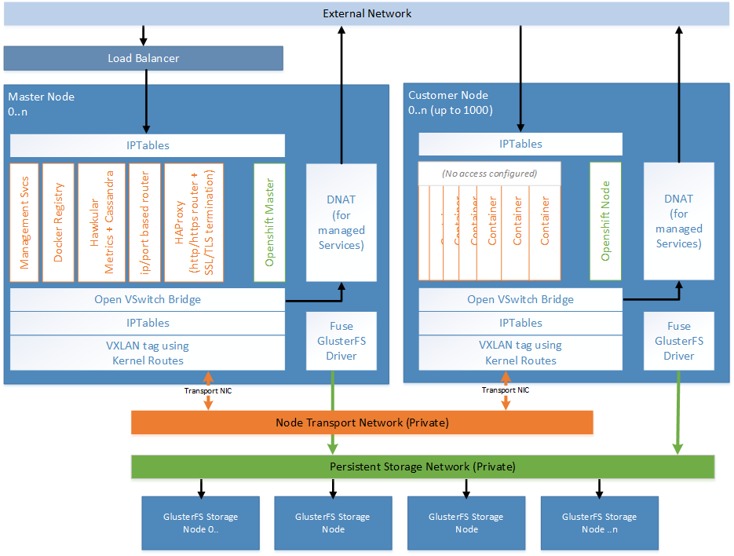
Notes:
A cluster is made up of Nodes (up to 1000 at the moment)
These Nodes are built in the same way (using Ansible to build them automatically)
Some nodes are used as Master nodes (all equivalent) - these Masters run management services, a local Docker registry, metrics services and, most importantly, the load balancers that serve traffic to the rest of the cluster.
The rest of the nodes are used to run customers’ services.
All nodes run containers. If the containers need persistent storage, this is provided by a ClusterFS cluster mounted on each of the Nodes.
The important thing to get your head around is the traffic flow for web traffic. This travels from the external network through to one of the master nodes. From here if it passed through to HA Proxy (in a container). This HA Proxy instance then passes the request(s) through to the right customer node (across the Node Transport Network).
The Open VSwitch Bridge determines whether traffic needs to be encapsulated and passed onto the Node Transport Network, or whether it’s destined for the Internet, in which case it gets passed through the DNAT.
All traffic that needs to travel between containers is VX-lan tagged and passed through the Node Transport Network (orange).
The VX-LAN tag is specific to the project in question, so no two customer projects can see each others network traffic (it’s as if each project has its own VLAN).
If any of the customers containers need to talk to the Internet (e.g. to access some other web service), they do so through the DNAT for managed services.
No direct inbound access is possible to customer containers - everything goes through the HAProxy instance on one of the masters (or the equivalent IP/port-based router)

Slide 19
Live Demo

Slide 20
(NOTE: PASTE IN PHOTO AND SEND BEHIND FOREGROUND GRAPHIC FOR CROP)
Help Us
Chat with 1&1 at Booth #G5
Register for the Closed Beta and win a trip to join 1&1 at ContainerDays EU in Hamburg
Email: baldwin@stackpoint.io
Twitter: @baldwinmathew
Notes:
We need to name the booth: Stop by Booth #G5.
Mention ContainerDays EU
Please mention the raffle (win a trip to the container days - 2 persons - 4* hotel, event tickets, airfare). Every participant will receive 100$ credit to test the new product, goes live on 4th of July

Slide 21
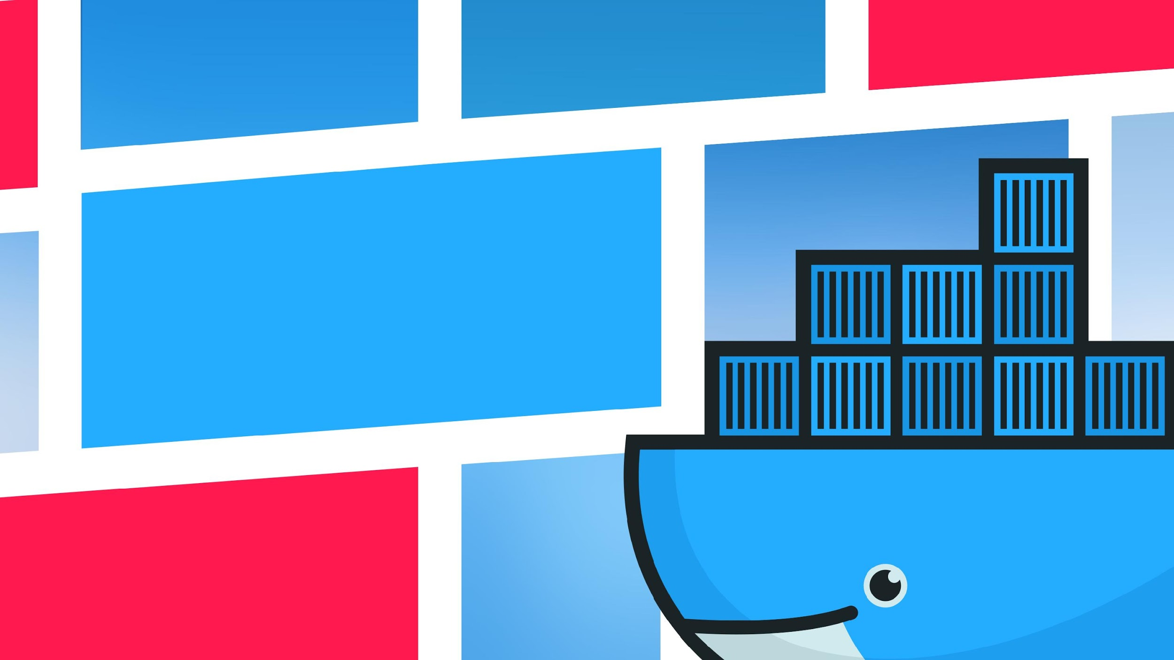
Thank you!

